Slide 1
Unit 6 Parallel Circuits
Part C: Analysis of Parallel Circuits
Notes:
Hi! Welcome to Unit 3: Resistance and Ohm’s Law, Part A on Resistance.

Slide 2
What will you learn?
Apply Ohm’s law, concepts of total resistance of a parallel connection, Kirchhoff’s Current Law (KCL) and Current Divider Rule (CDR) for circuit analysis.

Slide 3
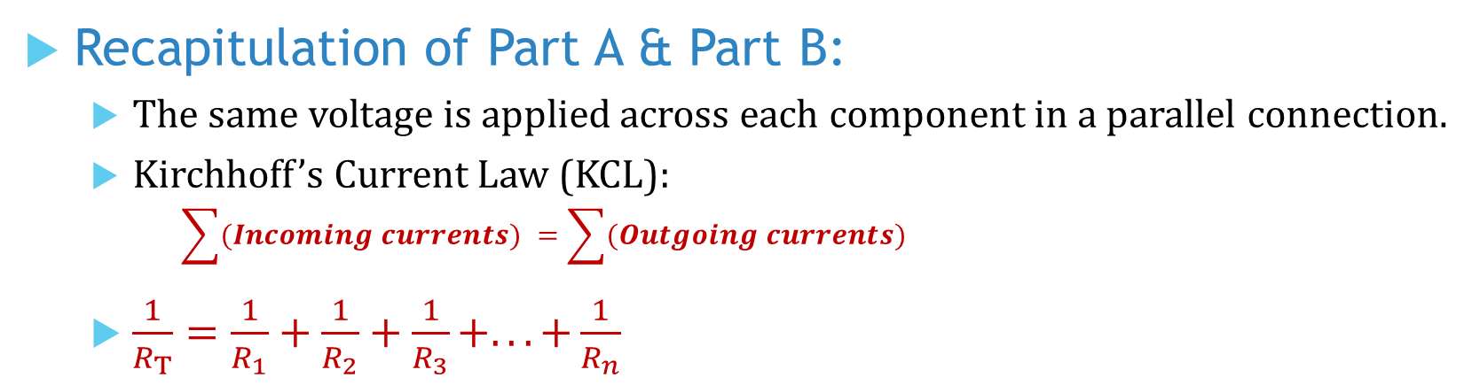
Recapitulation of Part A & Part B:
The same voltage is applied across each component in a parallel connection.
Kirchhoff’s Current Law (KCL):
$$\sum{(Incoming currents)} =\sum{(Outgoing currents)}$$
$\frac{1}{R_{T}}=\frac{1}{R_{1}}+\frac{1}{R_{2}}+\frac{1}{R_{3}}+...+\frac{1}{R_{n}}$

Slide 4

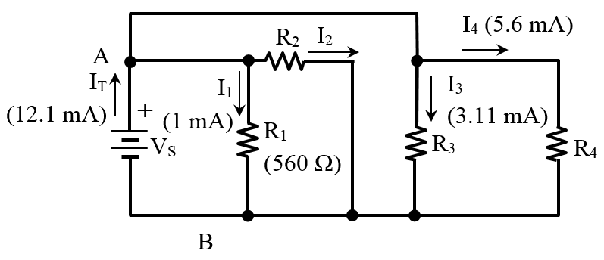
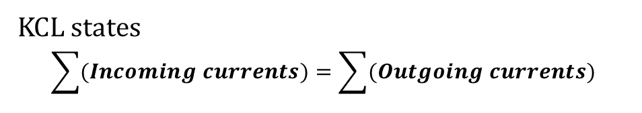
Example 1: Find the branch resistances R₂, R₃ and R₄, and the total resistance R_{T} across nodes A & B.
KCL states
$$\sum{(Incoming currents)}=\sum{(Outgoing currents)}$$
Apply KCL at node A to find I₂
I_{T} = I₁ + I₂ + I₃ + I₄
I₂ = I_{T} – I₁ − I₃ − I₄
= 12.1 – 1 − 3.11 − 5.6
= 2.39 mA
Apply Ohm’s Law to R₁
$$V_{AB}=I_{1}R_{1}=1 mA×0.56 kΩ=0.56 V=560 mV$$

Slide 5

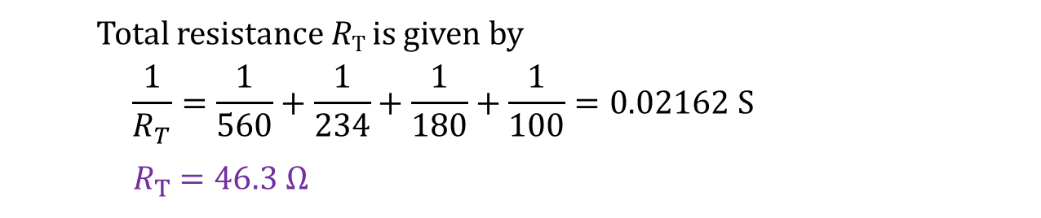
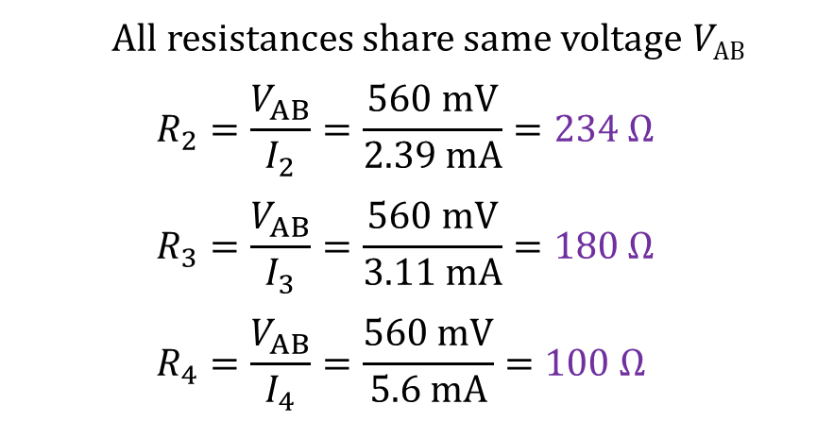
Example 1: For circuit shown, find branch resistances R₂, R₃ and R₄ and hence the total resistance (R_{T}) across A-B.
All resistances share same voltage V_{AB}
$$R_{2}=\frac{V_{AB}}{I_{2}}=\frac{560 mV}{2.39 mA}=234 Ω$$
$$R_{3}=\frac{V_{AB}}{I_{3}}=\frac{560 mV}{3.11 mA}=180 Ω$$
$$R_{4}=\frac{V_{AB}}{I_{4}}=\frac{560 mV}{5.6 mA}=100 Ω$$
Total resistance R_{T} is given by
$$\frac{1}{R_{T}}=\frac{1}{560}+\frac{1}{234}+\frac{1}{180}+\frac{1}{100}=0.02162 S$$
${ R}_{T} =46.3 Ω$
How would you check the answer for R_{T}?

Slide 6
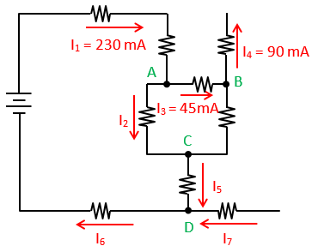
Example 2: Find the unknown branch currents in the circuit network.
Apply KCL at node A
I₂ = I₁ – I₃ = 230 mA – 45 mA = 185 mA
At node B,
I₃ = 45 mA is entering node B.
I₄ = 90 mA is leaving node B.
∵ I₄ > I₃ ∴ The current in branch BC must be entering node B.
I_{CB} = I₄ – I₃ = 90 mA − 45 mA = 45 mA
Apply KCL at node C
I₅ = I₂ − I_{CB} = 185 mA – 45 mA = 140 mA

Slide 7
Example 2: Find the unknown branch currents in the circuit network.
Currents entering and leaving a component must be equal.
I₆ = I₁ = 230 mA
Apply KCL at node D
I₇ = I₆ – I₅ = 230 mA – 140 mA = 90 mA

Slide 8
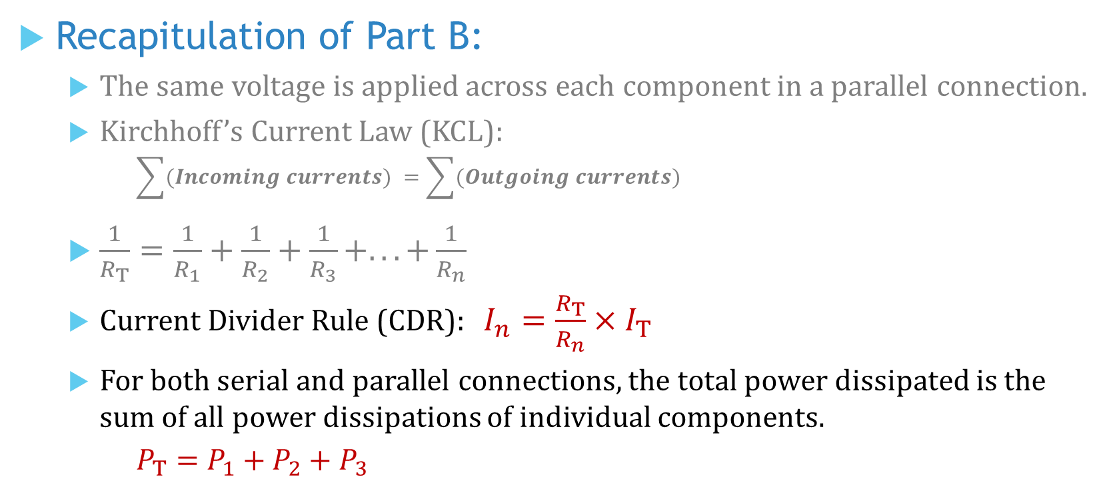
Recapitulation of Part B:
The same voltage is applied across each component in a parallel connection.
Kirchhoff’s Current Law (KCL):
$$\sum{(Incoming currents)} =\sum{(Outgoing currents)}$$
$\frac{1}{R_{T}}=\frac{1}{R_{1}}+\frac{1}{R_{2}}+\frac{1}{R_{3}}+...+\frac{1}{R_{n}}$
Current Divider Rule (CDR): $I_{n}=\frac{R_{T}}{R_{n}}×I_{T}$
For both serial and parallel connections, the total power dissipated is the sum of all power dissipations of individual components.
$$P_{T}=P_{1}+P_{2}+P_{3}$$

Slide 9
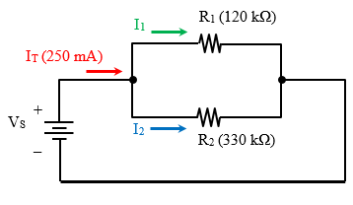
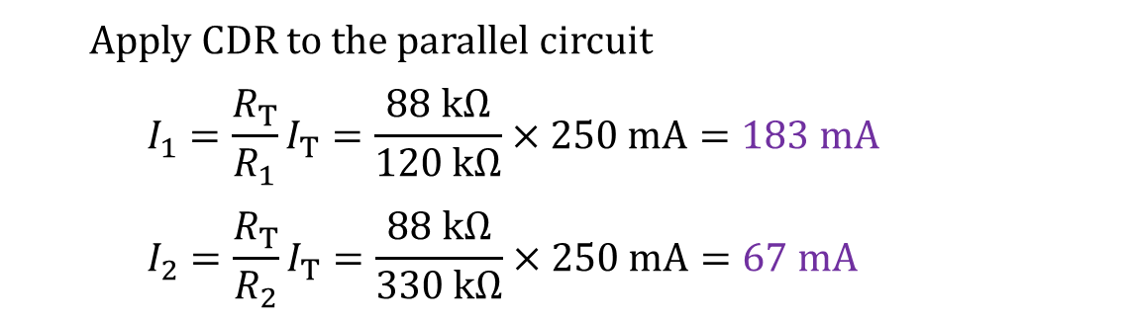
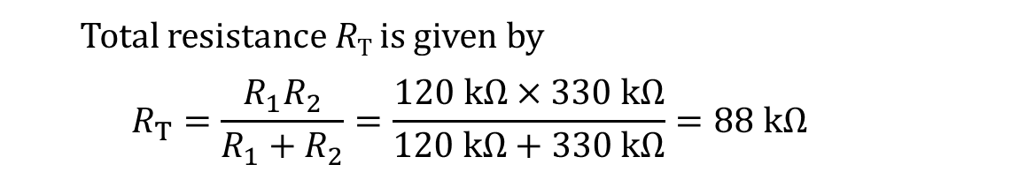
Example 3: Apply CDR to find branch currents I₁ and I₂ in this circuit.
Total resistance R_{T} is given by
$$R_{T}=\frac{R_{1}R_{2}}{R_{1}+R_{2}}=\frac{120 kΩ×330 kΩ}{120 kΩ+330 kΩ}=88 kΩ$$
Apply CDR to the parallel circuit
$$I_{1}=\frac{R_{T}}{R_{1}}I_{T}=\frac{88 kΩ}{120 kΩ}×250 mA=183 mA$$
$$I_{2}=\frac{R_{T}}{R_{2}}I_{T}=\frac{88 kΩ}{330 kΩ}×250 mA=67 mA$$

Slide 10
You have learned to
apply Ohm’s Law, concepts of equivalent or total resistance of a parallel connection, Kirchhoff’s Current Law (KCL) and Current Divider Rule (CDR) for circuit analysis.

Slide 11
Coming Up Next
Effects of Adding Parallel Branches

